Slide 1
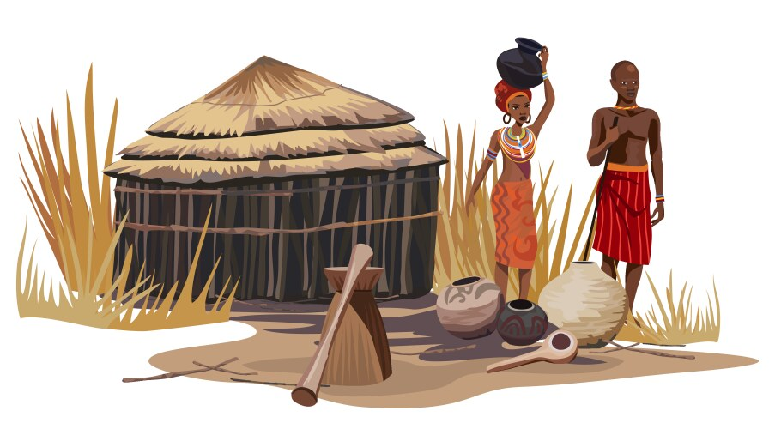
GrowRight Afrique: AI-Driven Crop & Soil Intelligence System

Slide 2
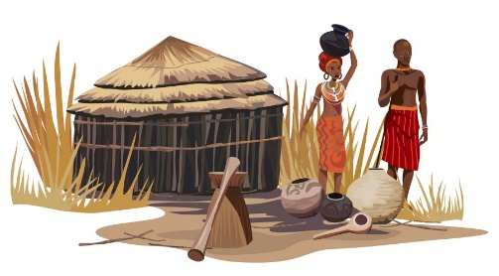
Members of Group 7
Faith Koech
Lucy Muchiri
Timothy Munene
Munene Gitonga
Isaac Macharia
Thomas Amuti

Slide 3
Highlights
Project Overview
Business Understanding: Business Problem and Objectives
Data Understanding
Data Preparation
Results
Recommendations
Limitations and Suggestions for further studies

Slide 4
Project Overview
Farmers struggle with crop yield prediction and fertilizer selection.
Driven by climate change, soil degradation, and rising input costs.
Current stages of soil prediction involves: Collection soil sample:
Assessment at KALRO (Kenya Agricultural and Livestock Research Organization).
With long waiting times – 3 weeks.
Local tools exist BUT rely heavily on devices (Soilpal)
Limited accessibility for rural farmers with low resources.

Slide 5
Project gap
Current tools depend on expensive chemical soil analysis.
Lack of user-friendly AI tools for farmers.
No strong image-based soil analysis systems widely available.
We therefore:
Plan to leverage on the use of physical characteristics as well as soil images.
Easier for farmers to observe and don’t need instruments.
By developing AI algorithms and hosting on easy to access Websites and phone apps.

Slide 6
Business Questions
How effectively can crop type be predicted by combining soil images with field-observed physical soil attributes?
How accurately can crop type be predicted using field-observed physical soil indicators (erosion signs, slope characteristics, surface stones, and crust formation)?
How accurately can crop type be predicted using soil images?
Notes:
Current model mirrors that of Plant Village Nuru:
Use image classification to detect diseased crops.

Slide 7
Stakeholders who may benefit
Local farmers – to predict:
Type of crop based on:
Physical Soil Attributes: Erosion type, surface salt, surface crust, surface stone e.t.c
Type of fertilizer to augment with: inorganic, crop residue, green manure, animal.
Ministry of agriculture – for fertilizer imports and location deployment.
Agricultural Food Authority – for yield predictions based on location.

Slide 8
Data Understanding
Dataset sourced from Soil4Africa (ISRIC platform) with two datasets:
1st: Contains Physical dataset with 54 features + crop type target.
2nd: Contains Image dataset with soil photographs.
Data merged using common plot_code identifier.
Target Variable: Crop type.
Feature Variables: 54 columns with features divided into: geographic, physical soil attributes, land management practices and grazing intensity indicators.
We focused solely on the physical soil attributes.
Notes:
Included: Crop type, presence of erosion, surface crust, surface salt, coarse fragments, gravel, land slope, presence of bare soil.

Slide 9
Libraries imported and used
We used several libraries:
Pandas, NumPy – Data cleaning & numerical processing.
Matplotlib, Seaborn – Data visualization & insights.
Base64, PIL, BytesIO – Image decoding & processing.
Scikit-learn – ML models, preprocessing & evaluation.
TensorFlow / Keras – Deep learning (CNN & Neural Networks).
Joblib, OS – Model saving & deployment.

Slide 10
Data cleaning – 1st dataset on physical attributes
Started with 13876 entries with 55 columns:
Removed columns with high missing values (>41%).
With drop from 55 columns to 39.
Dropped redundant duplicate columns.
With drop from 39 columns to 37.
Removed remaining null rows.
With drop of entries from 13876 to 2467.

Slide 11
DATA CLEANING – 2nd dataset on soil images
Scraped soil images using Selenium automation.
Confirmed accurate loading of the images in base 64 format.
Had horizontal_up, horizontal_down, vertical photos.
Filtered images and kept only “horizontal_up”.
Decoded the images and converted them to numpy arrays for ML modelling.
Dropped the horizontal_up base_64 columns.
Confirmed null missing and duplicated values.
Notes:
Working with the above format is associated with the following:
* Large file size overhead → Base64 encoding increases size by ~33%, making storage and transfer less efficient compared to normal image files
* Memory usage → Entire image must be loaded into memory as a string before decoding, which can be heavy for large datasets or many images
* Slower processing → Requires encoding/decoding steps, adding CPU overhead when reading or writing images
* Harder to manage → Images are embedded in text, so you can’t easily preview, edit, or organize them like normal .png/.jpg files.
Secondly, we noted by viewing the images that the vertical photos all have noise data including:
* Hand tools used by the farmers.
* Holes dug by the farmers.
These may lead to:
* Spurious feature learning (shortcut bias) - The network may latch onto tools or hole shapes instead of soil properties. This is a classic case of models exploiting Spurious Correlation, where non-causal cues become predictive simply because they co-occur with labels.
* Reduced generalization. If test images don’t contain tools/holes (or contain different ones), performance drops. The model hasn’t learned soil characteristics; it learned context artifacts.

Slide 12
Final Output from Data Cleaning
From the 1st dataset on physical soil attributes:
2467 entries with 37 columns (including identifier: plot_id)
From the 2nd dataset on soil images:
396 images with only numpy arrays of the horizontal_up photos and plot_id (identifier)
Concatenated the 2 dataset to have 1 unified Kenyan dataset for image classification:
87 entries with 38 columns.

Slide 13
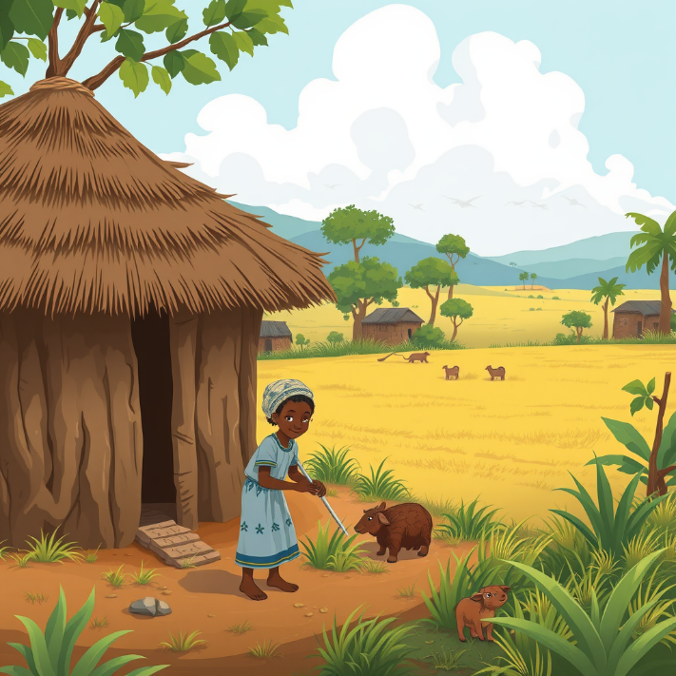
Results

Slide 14
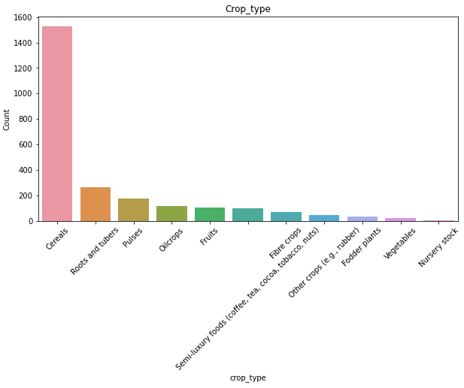
CROP TYPE

Slide 15
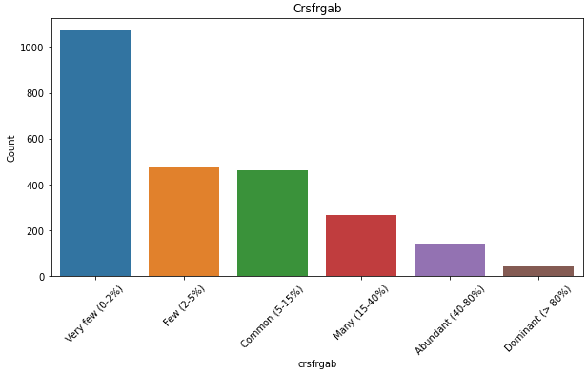
Coarse fragments abundance

Slide 16
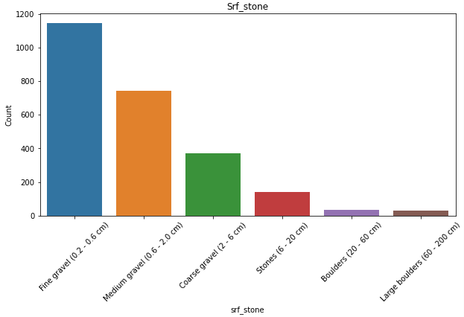
Surface stone

Slide 17
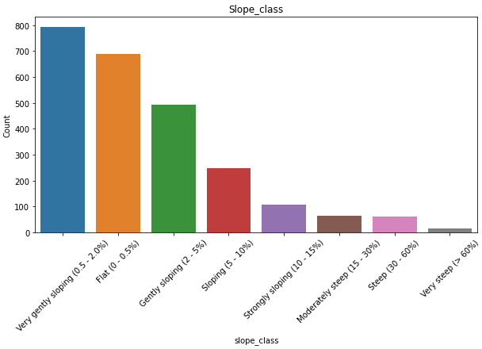
SLOPE CLASS

Slide 18
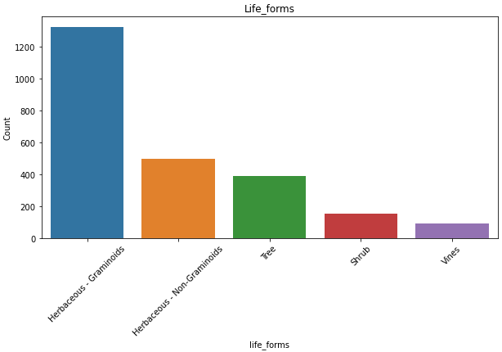
Life forms

Slide 19
Most land
Had:
No signs of erosion.
No surface crust.
No surface stone
No Bare soil.
Was level land and sloping land. Very few was steep land.

Slide 20
Determining which physical attributes predicted crop type better.
Vegetation factors dominate crop prediction accuracy.
Herbaceous (Non-Graminoids) – 0.79 (strongest predictor)
Tree-based vegetation – 0.73
Vines presence – 0.71
Shrub vegetation – 0.65
Flooded / aquatic cultivated land – 0.50

Slide 21
Determining the relation between physical attributes and crops grown.
Most crops require cultivated land with no erosion, salt, crust, or bare soil
Cereals, Vegetables, Rubber → Flatland crops (flat terrain, fine gravel)
Fodder plants → Flatland + flood-prone areas (high water association)
Fruits, Fibre, Oil-crops, Pulses → Gentle slope crops (tree-linked systems)
Roots & Tubers → Irregular crops (sloped land, irregular field patterns)
Semi-luxury & Nursery crops → Special cases (tree/shrub systems or coarse, sloping, fragmented land)

Slide 22
Determining the relation between fertilizer option and crops grown.
Cereals: Crop residue + inorganic fertilizer.
Fibre crops: Mainly inorganic fertilizer.
Fodder plants: Crop residue or inorganic fertilizer.
Fruits: Crop residue + animal manure (secondary).
Oil-crops & Roots/Tubers: Mainly crop residue.
Vegetables & Semi-luxury crops: Mixed use of inorganic fertilizer, manure, and crop residue.

Slide 23
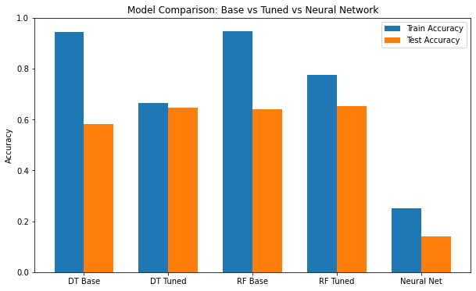
Modelling – PHYSICAL ATTRIBUTES

Slide 24

Modelling – SOIL IMAGES CLASSIFICATION
We used a Convolutional Neural Network with:
Accuracy – 91%
Validation Accuracy – 81%.

Slide 25
DASHBOARD TUTORIAL

Slide 26
Recommendations
Despite the general recommendations, use AI models for crop prediction.
Crop choice depends on multiple soil factors, so machine learning models should guide decisions.
Promote crop residue as the main fertilizer.
Most crops perform best with crop residue, often combined with inorganic fertilizer.

Slide 27
Limitations of the dataset
Small image dataset (only 87 usable Kenyan soil images).
Limited data for soil image classification + reduced diversity but CNN performed well.
Severe class imbalance across crop types affected modelling for physical attributes.
Vertical images contained noise (tools, holes, hands) limiting use.
Fertilizer recommendations are made based on usage, not yield or soil health

Slide 28
Suggestions for further studies
Expand dataset with more soil images across African countries.
Include different climates, seasons, and farming conditions.
Incorporate crop yield and crop health data.

Slide 29

Thank you

